Slide 1
Systems Monitoring Server Build 1
Henry Zektser
Jorge Castro
Martha Agbugui
Zemenu Guanche
Notes:
MARTHA: Hello. This is the build 1 presentation for the systems monitoring server. The team members for this project are Henry, Jorge, Martha, and Zemenu

Slide 2
Project Concept – Technology Solution
This solution is a comprehensive systems monitoring server that combines monitoring, alerting, and user visibility in a unified platform.
Notes:
MARTHA: The systems monitoring server combines monitoring, alerting, and user visibility in a unified platform. Specifically, the system will allow users to define servers to monitor by providing an IP or an http(s) URL, and a list of users’ email addresses to alert in the event of issues. The system will continually monitor all IPs via ping and URLs via curl, and email alerts in the event of invalid status codes. A status page, showing a list of monitored servers, their current pass/fail state, and any recent issues will also be provided.

Slide 3
Project Concept – Stakeholders
DevOps Teams
IT Administrators
Support Engineers
Notes:
MARTHA:
This solution addresses the needs of three groups of stakeholders.
DevOps teams, who often encounter difficulties in identifying issues early due to a lack of real-time insights, leading to extended downtime and increased operational costs.
IT administrators who grapple with manual incident management processes, causing delays in response and resolution times, adversely affecting system performance and user experience.
And Support engineers who face erosion of customer trust when they fail to provide timely and transparent updates about incidents, potentially leading to customer churn

Slide 4
Project Concept – Development Environment
Infrastructure
GitHub
Jira
Docker
MongoDB
Keycloak
Frontend
TypeScript
ReactJS
ViteJS
GraphQL
Patternfly
Backend
Go
Gin
GraphQL
gqlgen
Notes:
ZEMENU: Our development environment leverages github for source control, integrated with jira for project tracking. Docker is utilized to run all components in a containerized environment. MongoDB is our chosen database technology, and Keycloak is our IDP, providing SSO functionality. The frontend consists of a react application coded with TypeScript, and bundled with Vite. Patternfly is used for UI components, and graphql is utilized for all back-end data operations. The backend is coded in go, using gin as the web server library. GraphQL data operations are provided, with gqlgen being used to generate the schema code.

Slide 5
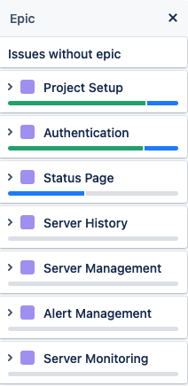
Accomplishments
Development environment established
Coding under way (~25% completed)
Authentication and Authorization completed
MongoDB storage implemented for all entities
GraphQL queries and mutations implemented for all entities
Dashboard page development under way
Notes:
ZEMENU: A development environment has been established, and coding is well underway for our project. We are approximately 25% code-complete. To date, we’ve implemented authentication and authorization, including SSO integration. We’ve also implemented the entire data model, including mongodb storage and graphql queries and mutations for all entities. The dashboard page is partially complete as well. We will drill into these in subsequent slides.

Slide 6
Development Environment Demo
Notes:
ZEMENU: Lets start with a demo of the development environment and a quick walkthrough of the code.

Slide 7
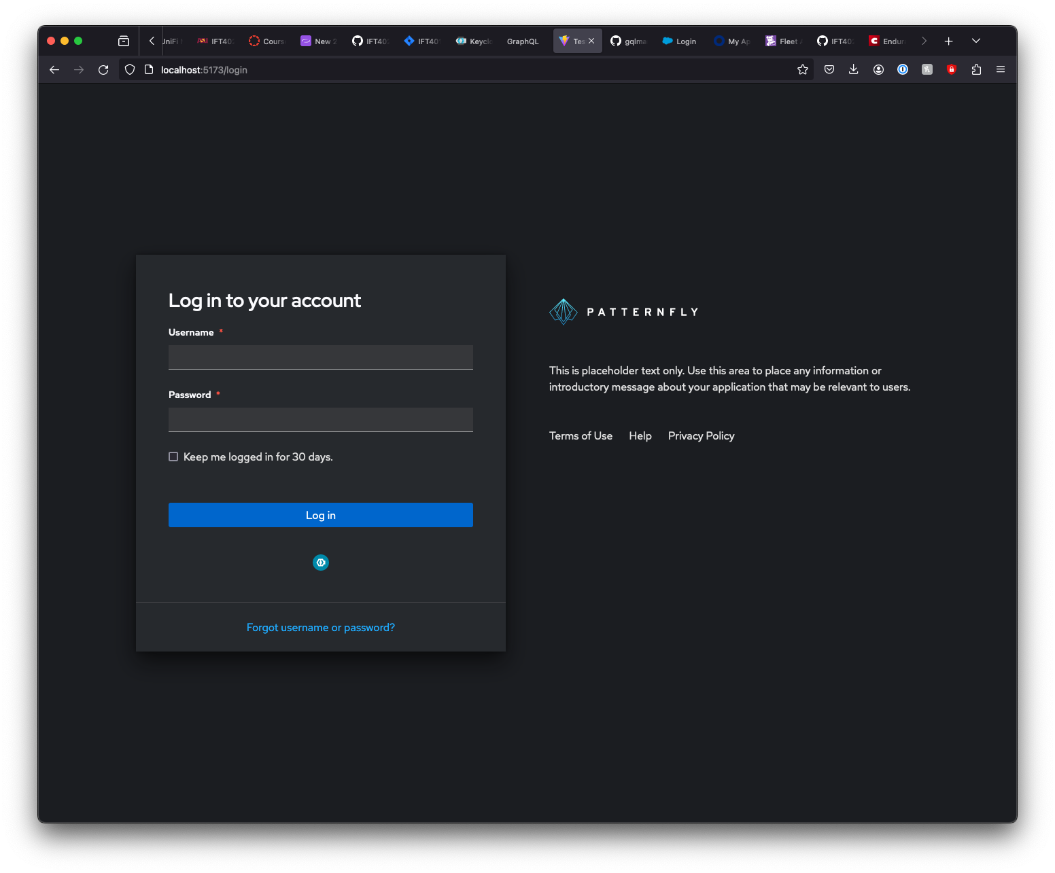
Accomplishments - Authentication
Username/Password flow functional
Keycloak (SSO) flow functional
2FA via Keycloak functional
Notes:
ZEMENU: For authentication, we are able to log users in via a standard local user flow. We are also able to allow users to SSO from keycloak, including with 2FA. Let’s take a look at a demo.

Slide 8
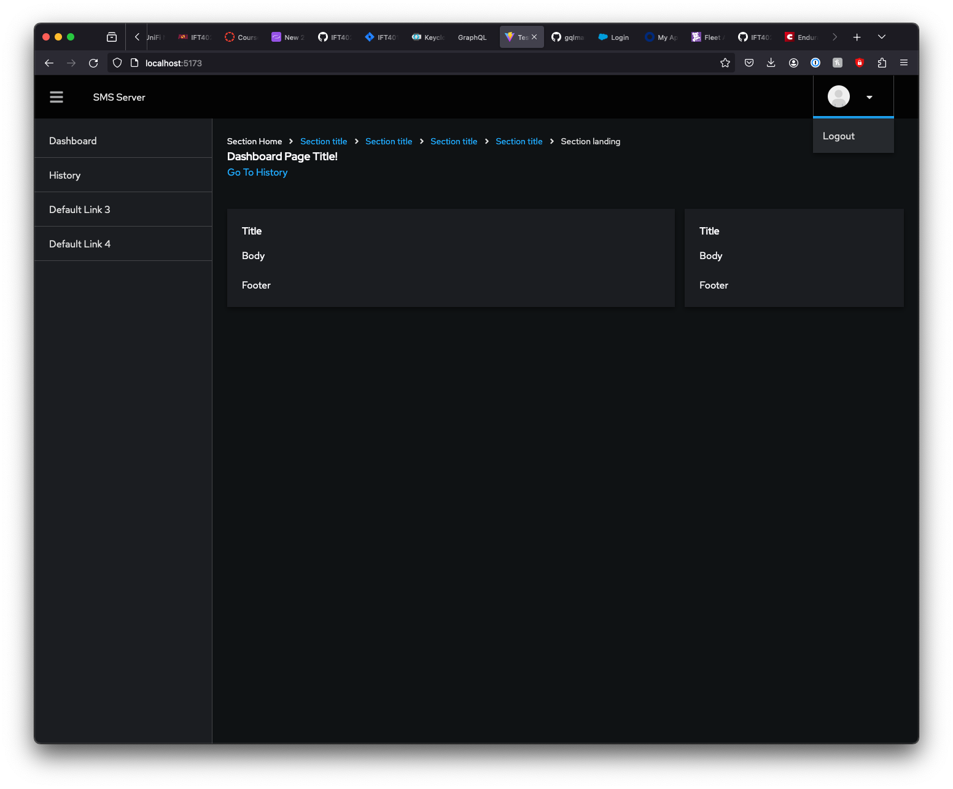
Accomplishments - Dashboard
Skeleton page completed
Menus functional
Navigation functional
Logout functional
Notes:
ZEMENU:The dashboard page is well under way, with the skeleton page completed. React navigation has been wired up, menus are functional, including state changes. Logout has also been implemented globally. Lets look at a demo of this functionality.

Slide 9
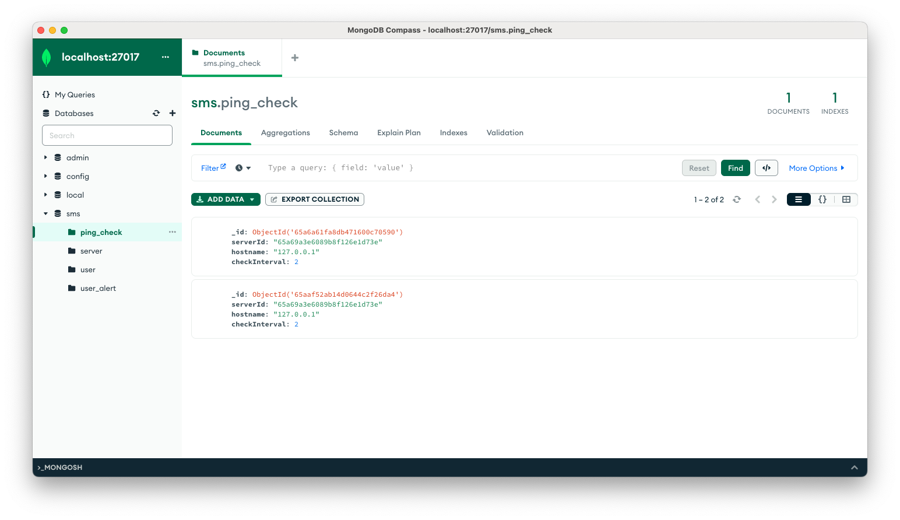
Accomplishments - MongoDB
MongoDB schema implemented
CRUD operations coded and tested
MongoDB management configured
Notes:
JORGE: The mongodb storage layer has been completed, including all CRUD operations, and mongodb management built-in.

Slide 10
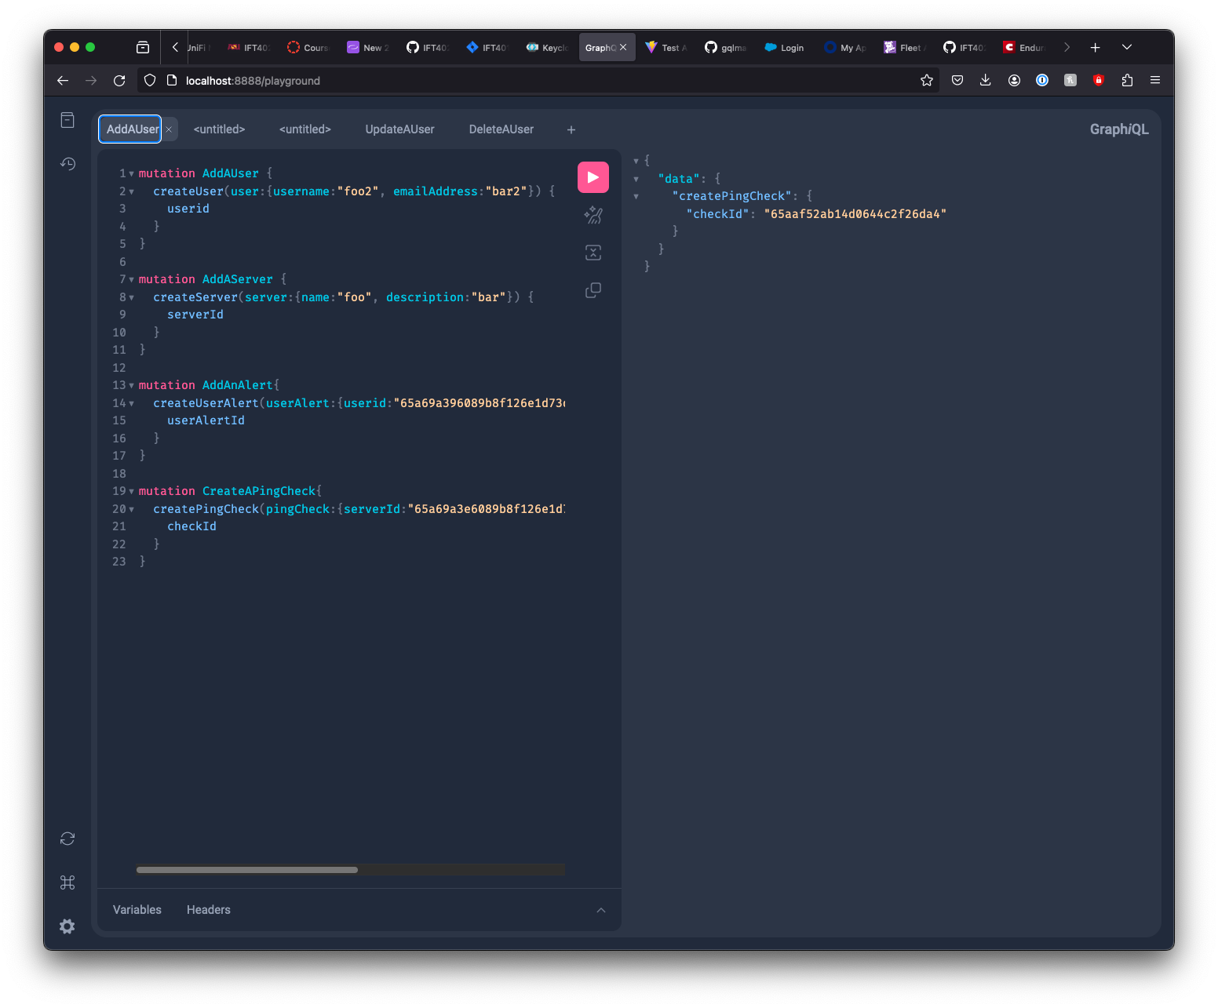
Accomplishments - GraphQL
GraphQL layer coded
All objects defined and generated via gqlgen
All resolvers for queries coded and tested
All resolvers for mutations coded and tested
Server implemented
Introspection enabled
Subscriptions via WebSocket enabled
GraphQL playground added
Dev-mode only
Notes:
JORGE: The mongodb layer has been exposed to the frontend via graphql as well. The entire GQL layer is coded, with all objects being generated by gqlgen. All resolvers for queries and mutations have been coded and tested. The graphql endpoints have been added to the backend server code, including introspection and websocket subscriptions, and for ease of development, the graphql playground has been enabled for dev mode deployments. Lets take a look at a demo of MongoDB and GraphQL

Slide 11
Problems
Problem 1: The hosting environment we were intending to use is no longer available to us, leading to an inability to configure CI/CD.
Solution 1: An alternative CI/CD solution was found in GitHub Actions, which is freely available to ASU students. Implementation is under way.
Notes:
HENRY: We had intended to use an AWS-based hosting environment for this project. Unfortunately, the account we intended to use is no longer available to us. We’ve identified github actions as an alternate environment, which provides us the needed compute and ci/cd resources as part of our ASU subscription. This new solution is under development now, and we expect to be able to demo it in build 2.

Slide 12
Problems
Problem 2: Kubernetes has switched from using standard Docker to podman as a runtime. As a result, not all Docker containers are usable, as they do not all support the OCI standard.
Solution 2: Where necessary, Buildah is being used to re-build containers to ensure OCI compatibility. MongoDB is the only container impacted thusfar and has been resolved.
Notes:
HENRY: We also discovered that mongodb would not run on our Kubernetes cluster, as docker is no longer supported, and Kubernetes uses podman instead. We identified that the switch to podman necessitated support for the OCI container standard, which the mongodb container did not fully support. We resolved this problem by building our own mongodb container, utilizing the open-source code published by MongoDB, using buildah instead of docker. This enabled us to run the container on Kubernetes and bypass the compatibility issue.

Slide 13
Schedule
Martha Agbugui
February
Dashboard page UI
Wiring to backend
Server History page UI
Wiring to backend
March
Frontend Unit Tests
Jorge Castro
February
New/Edit Server page UI
Wiring to backend
New/Edit Alert page UI
Wiring to backend
March
Frontend Unit Tests
Notes:
HENRY: As we are a disconnected team, and do not have daily standups, we elected to separate our development tasks by functional area to minimize conflicts and merge issues. Martha will be focused on the dashboard and server history pages in February, including graphql connections to the backend server. Unit tests will be her focus in March. Similarly, Jorge will work on the Server and Alert management pages in February, with unit testing to follow in march.

Slide 14
Schedule
Zemenu Guanche
February
New Check page UI
Wiring to backend
Realtime Status Page updates
Frontend WebSocket integration
March
Frontend Unit Tests
Henry Zektser
February
Backend check runner
Realtime Status Page updates
Backend WebSocket integration
CI/CD
March
Backend Unit Tests
Integration Tests
Notes:
HENRY: Zemenu will focus on the new check page in February, along with the front-end work to connect real-time updates from the status page to the dashboard and server status pages. Again, unit tests will follow in march.
Finally, Henry will be focused on the backend functionality to run the server checks on the backend, and push real-time updates. CI/CD will also be on Henry’s plate for February, with unit and integration tests to follow in march.
As you can see, we’ve chosen to defer testing code to the end of the project. The intention is to provide ourselves some buffer, allowing us to omit some less-important tests in the event that development of primary functionality takes longer than expected.

Slide 15
Thank You
Notes:
HENRY: Thank You

